Slide 1

Low-Dimensional Trajectories and Attractors in the Activity of Vasoactive Intestinal Peptide (VIP) Cells in the Mouse Visual Cortex
Presenters: Fariba Jangjoo (Kavli Institute for Systems Neuroscience, Norway) Pramod Kaushik (IIIT Hyderabad, India) Ulrich Stoof (University College London, UK)
Mentors: Alejandro Jimenez-Rodriguez (University of Sheffield, UK) Michael G. Levy (University of California, Berkeley, USA)
Neuromatch Academy (NMA), Virtual Summer School 23nd July 2021

Slide 2
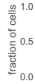
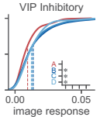
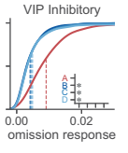
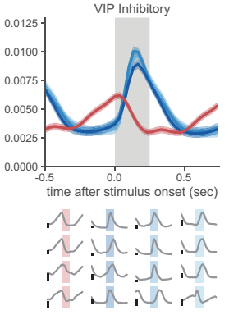
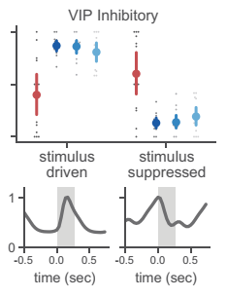
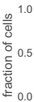


Background
Why VIP Cells
Major class of inhibitory neurons in sensory cortex
Mediate top-down influences, neuromodulation
React differentially to familiar / novel stimuli (1-3)
Ramping activity in case of image omission but only in sessions with familiar images (1,3)
Activity influenced by arousal and running
Gap and Research Question(s)
VIP cell trajectories have not been explored, thus, we did an explorative analysis on VIP dynamics to understand e.g. how memory might evolve
Trajectories in image changes and omissions
States and attractors under different conditions
1
2
3
Source: Garrett et al. (2020), Experience shapes activity dynamics and stimulus coding of VIP inhibitory cells

Slide 3
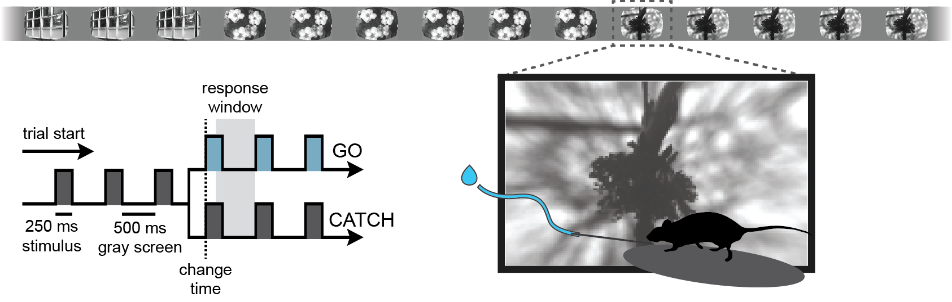
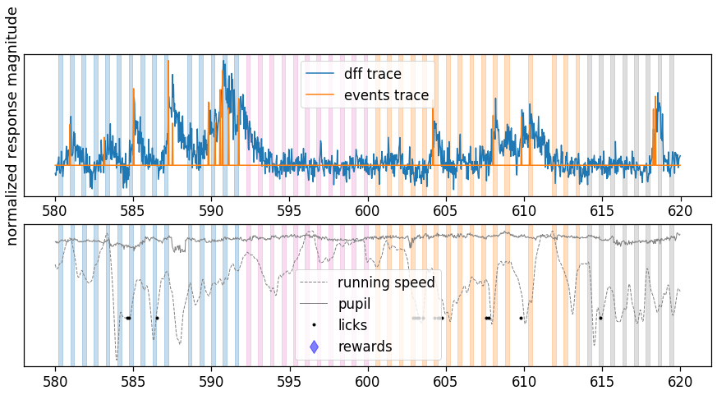
Method
Data / Experimental Paradigm
Allen Institute 2-photon behavioural data set, trained mice needed to detect change in the presented images
Activity of different neural cell types were recorded + other measurements, e.g. response, running, pupil size, were taken
Random omission on 5% of non-change trails
Approach / Method
Extract VIP recordings [-3s : 3s] at different events, e.g., omitted and at image change
Smoothing: half-Gaussian filter (SDK) and additional numpy convole
Use PCA to derive the first two PCs, plot trajectories and compare different “conditions”
Source: Allen Institute (2021), https://allensdk.readthedocs.io/

Slide 4
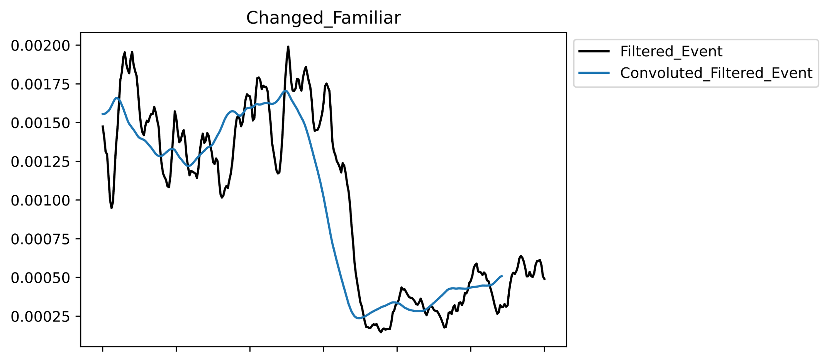
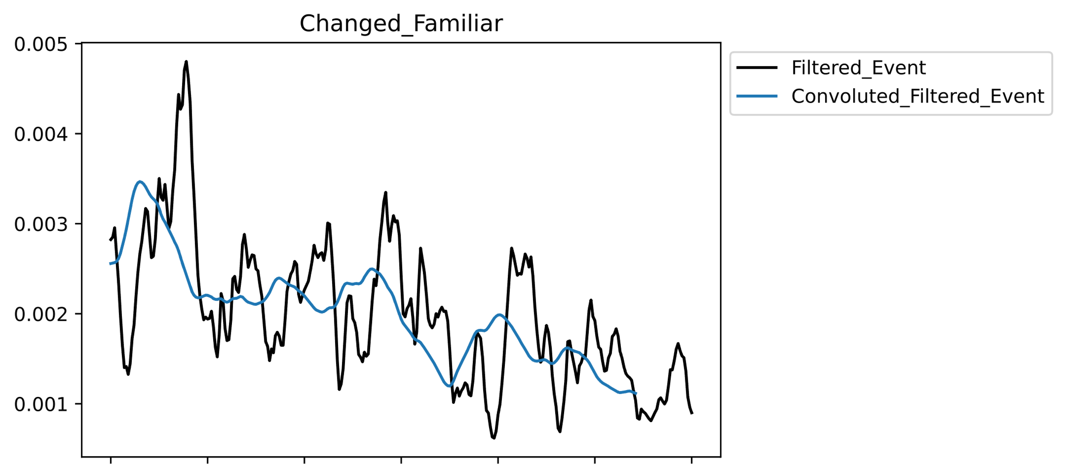
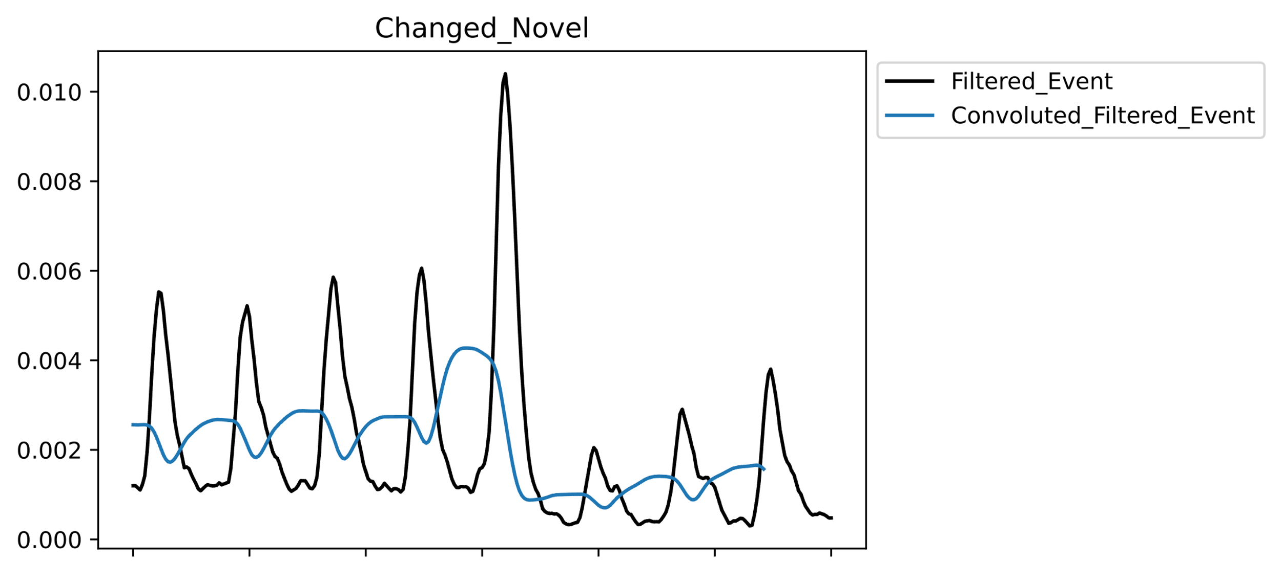
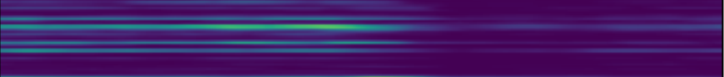
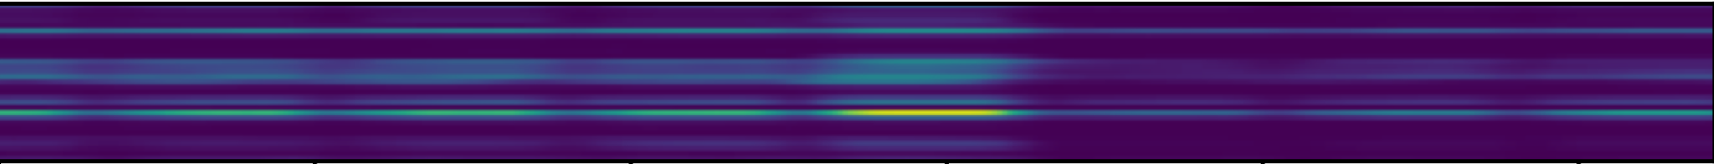
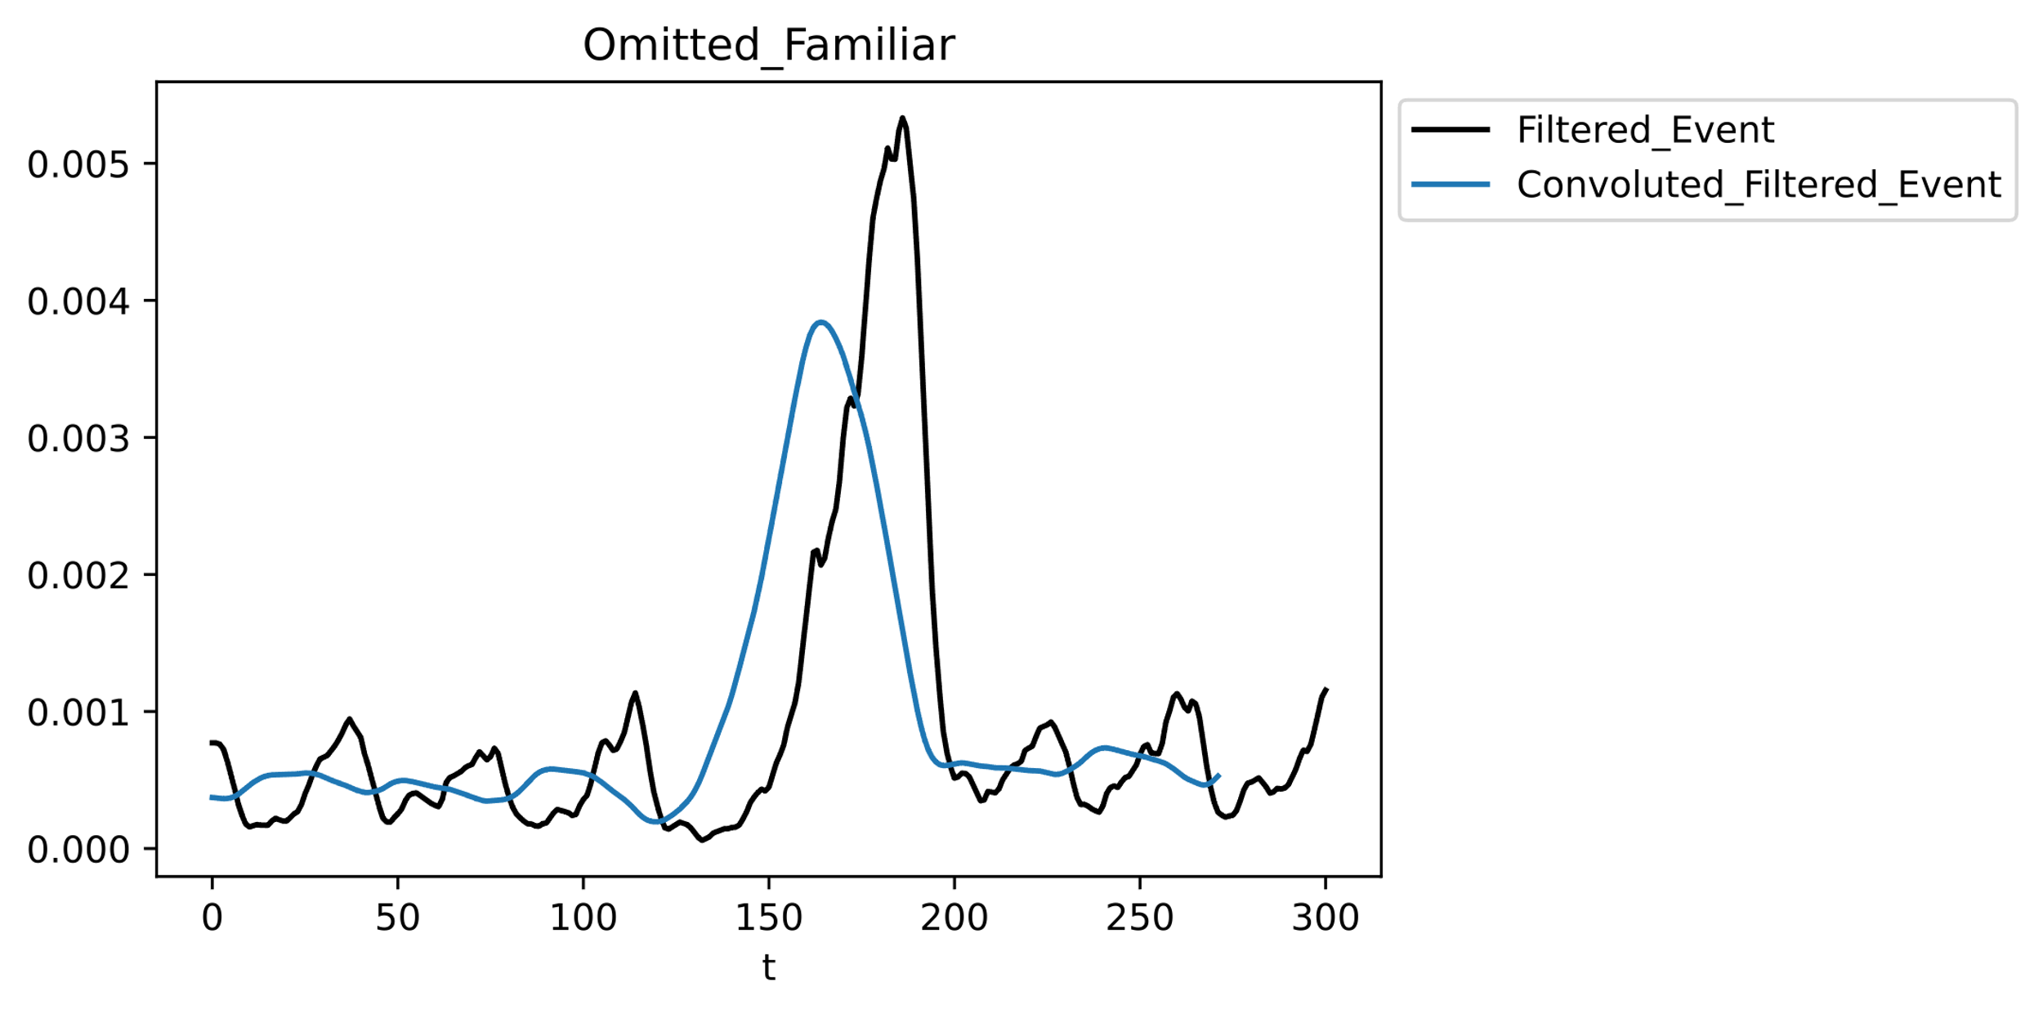
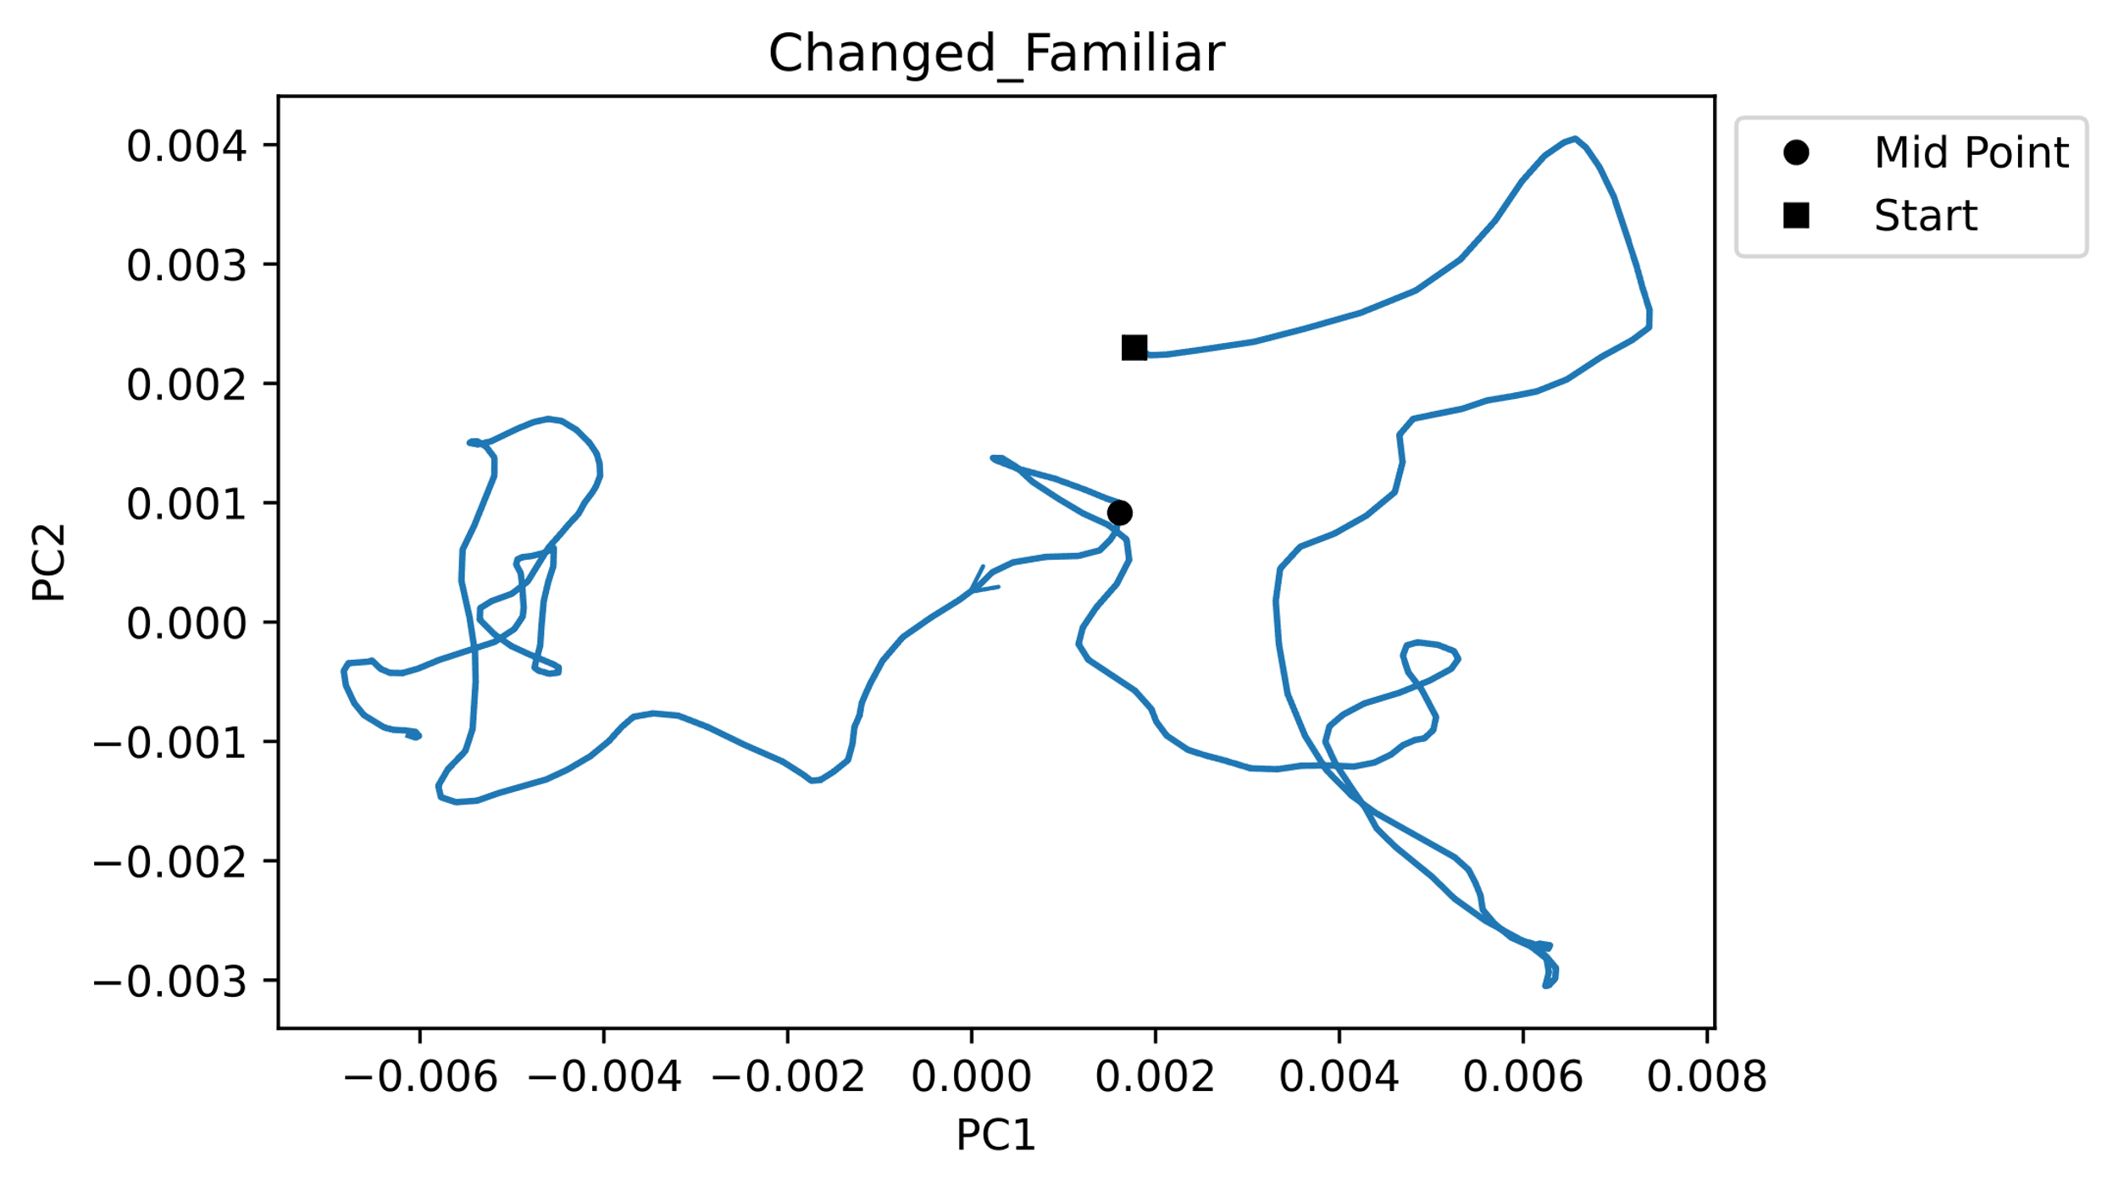
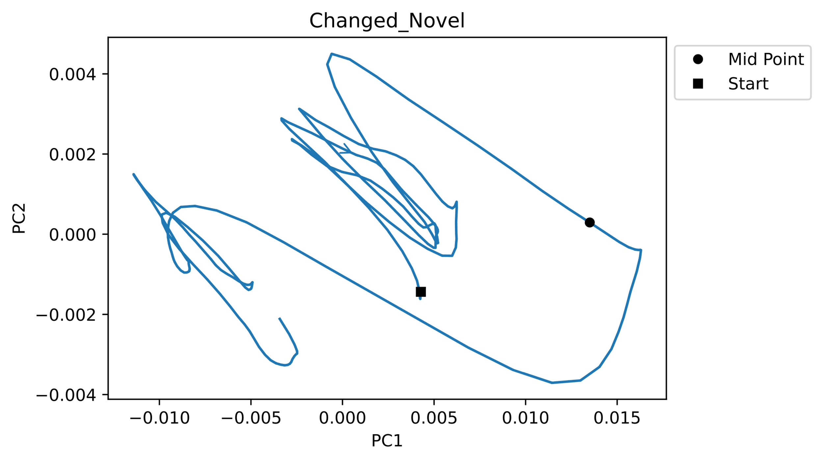
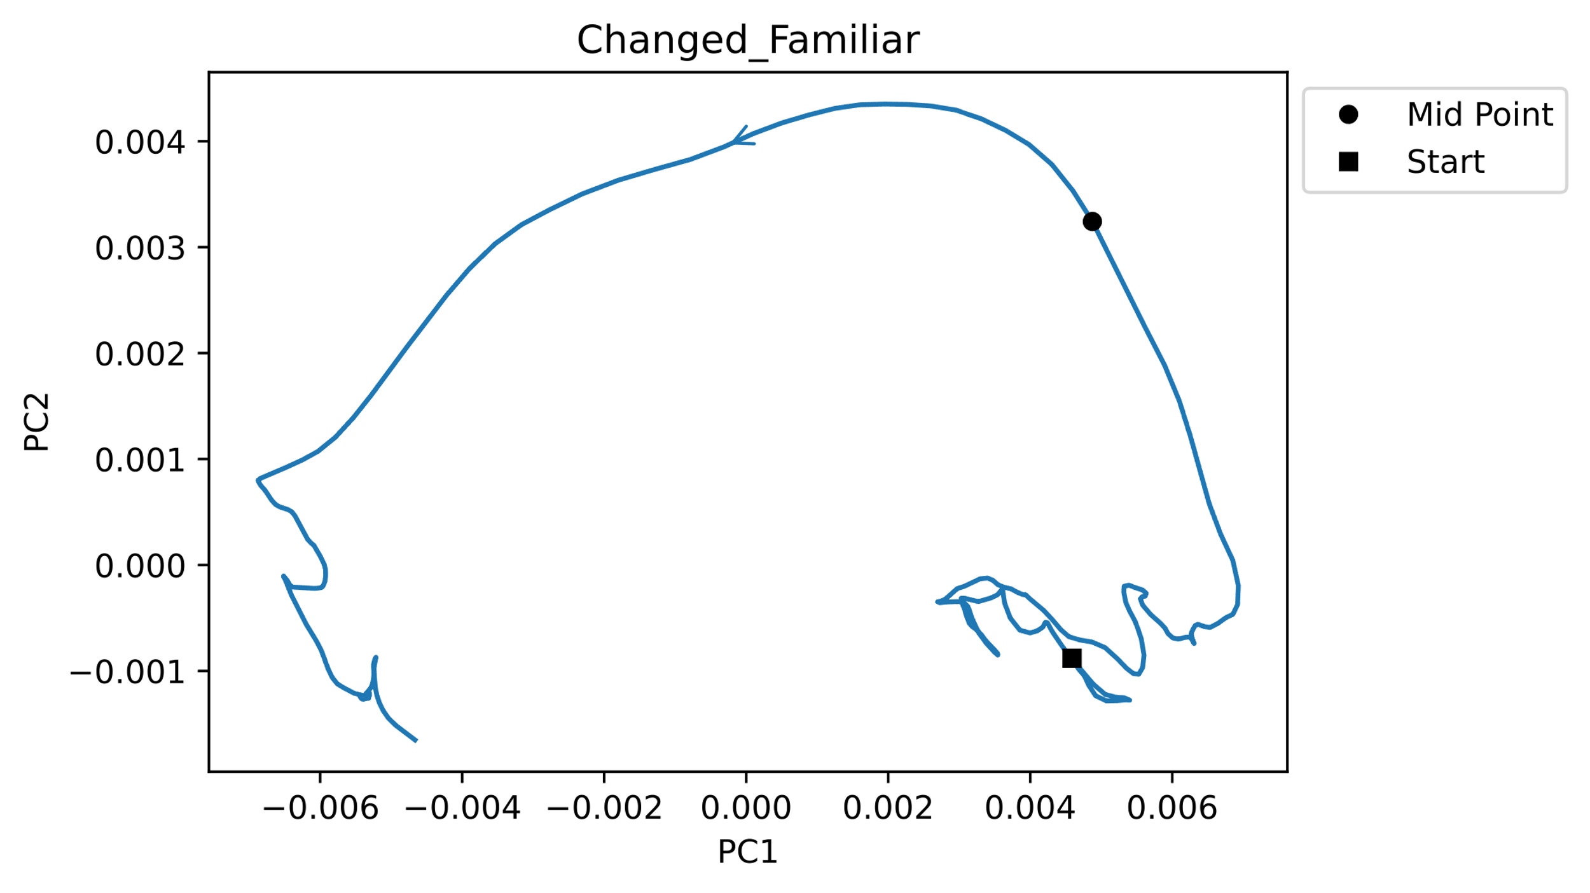
Results – 1 Change detection triggers move towards second attractor (stable state).
Notes:
Familiar images: show earlier excursion, oscillation around the stimulus presentation
Novel images: show oscillation before stimulus presentation, and relatively late excursion
Heteroclinic orbit / bifurcation in which one of the equilibria loses stability, and drives the trajectory towards another one

Slide 5
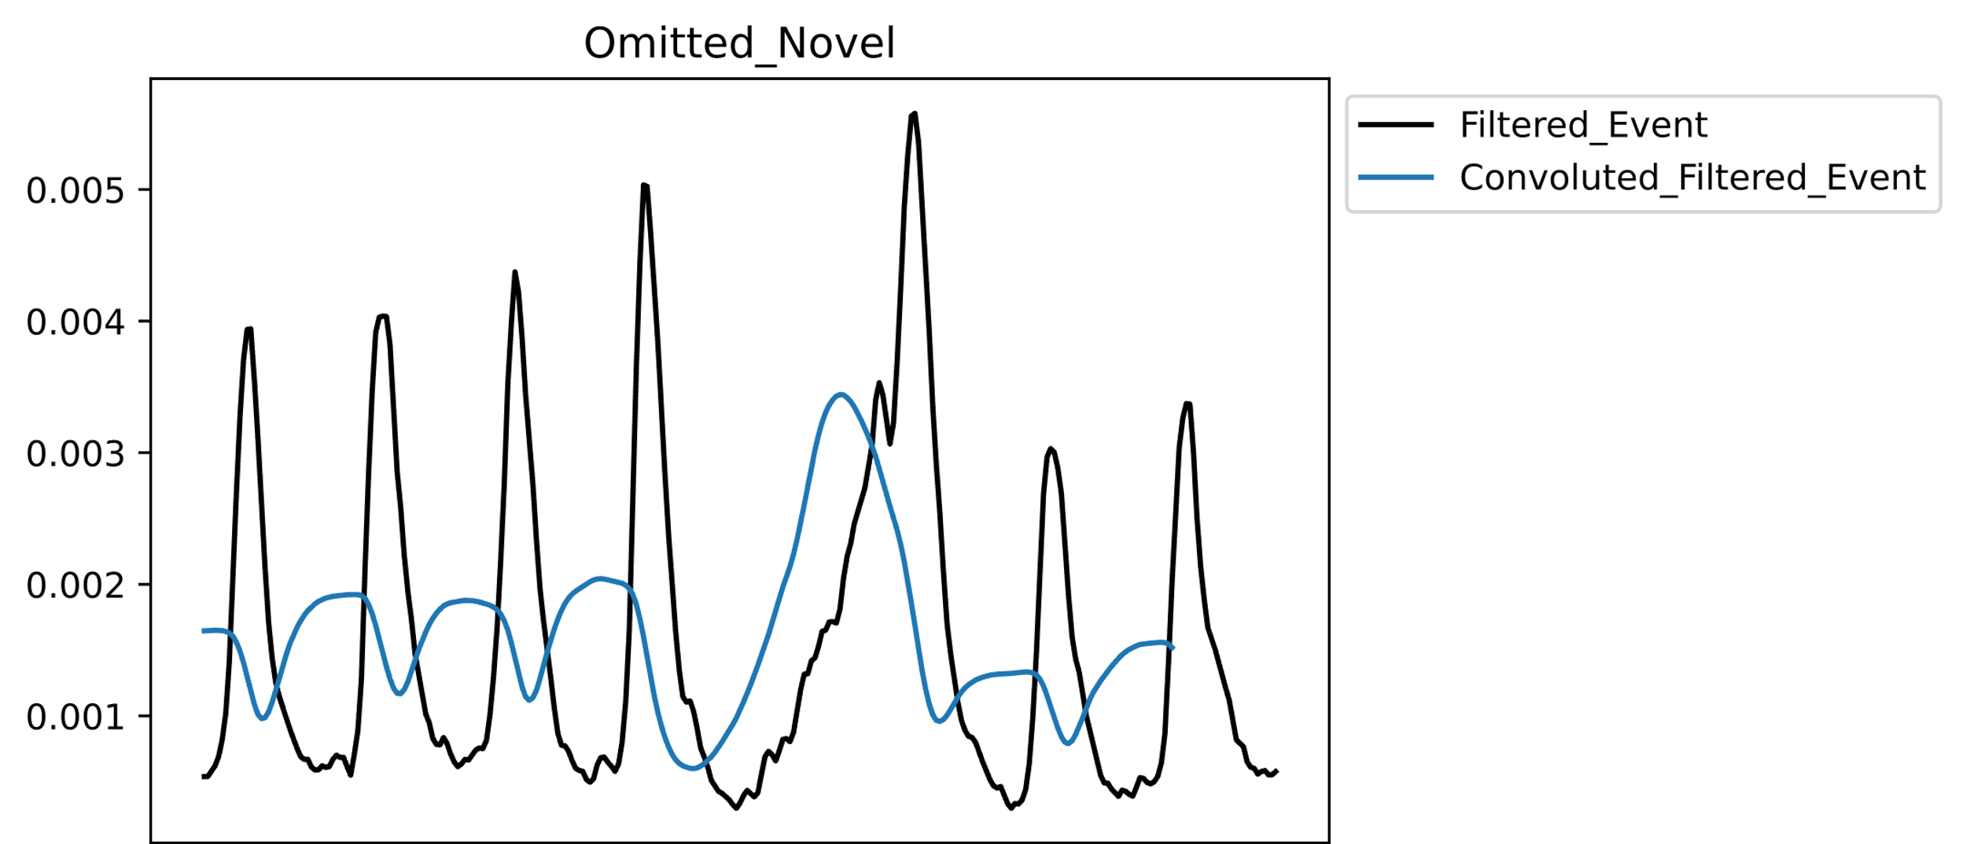
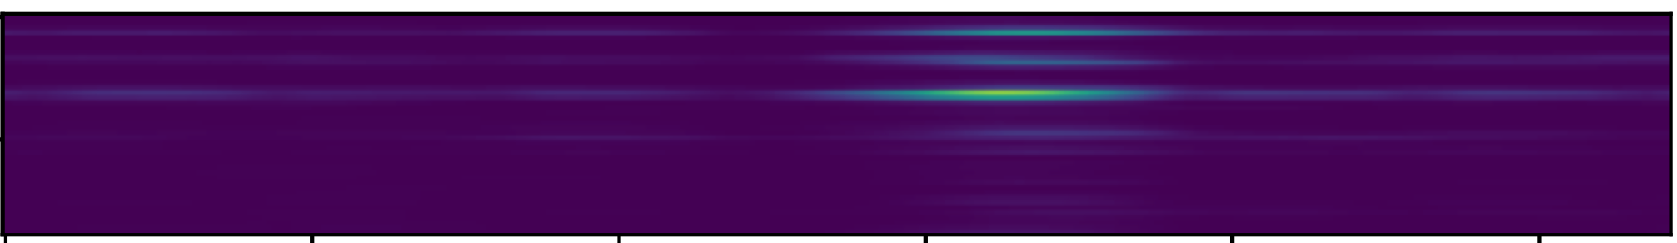
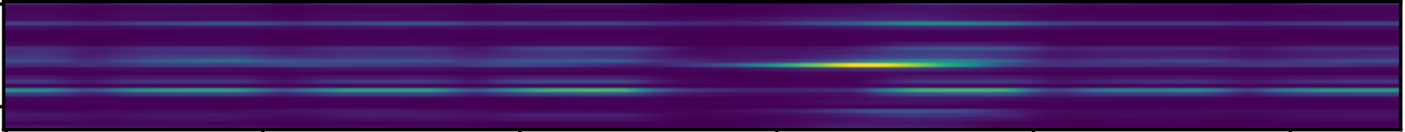
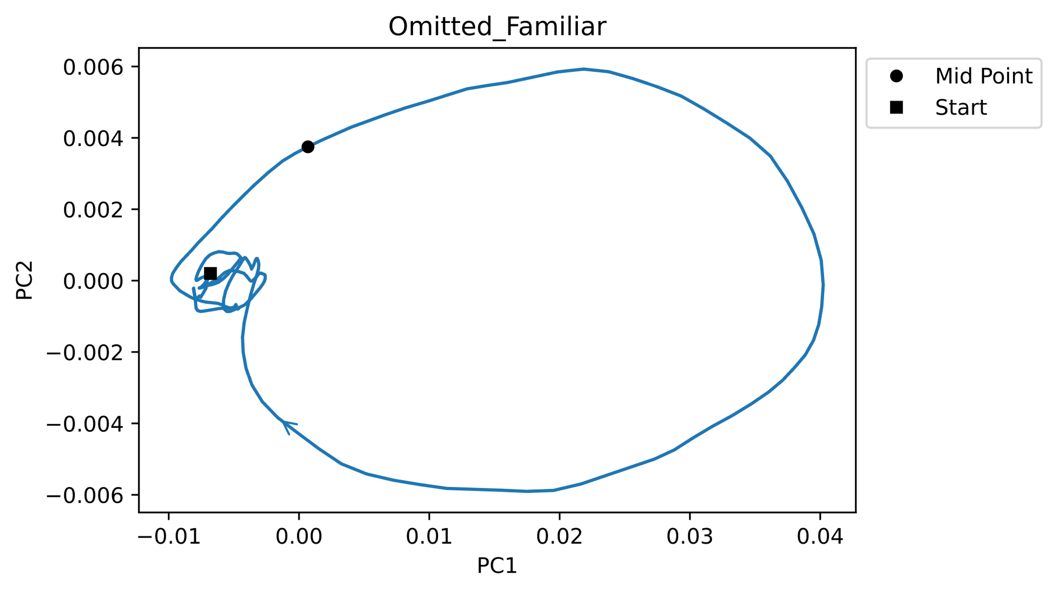
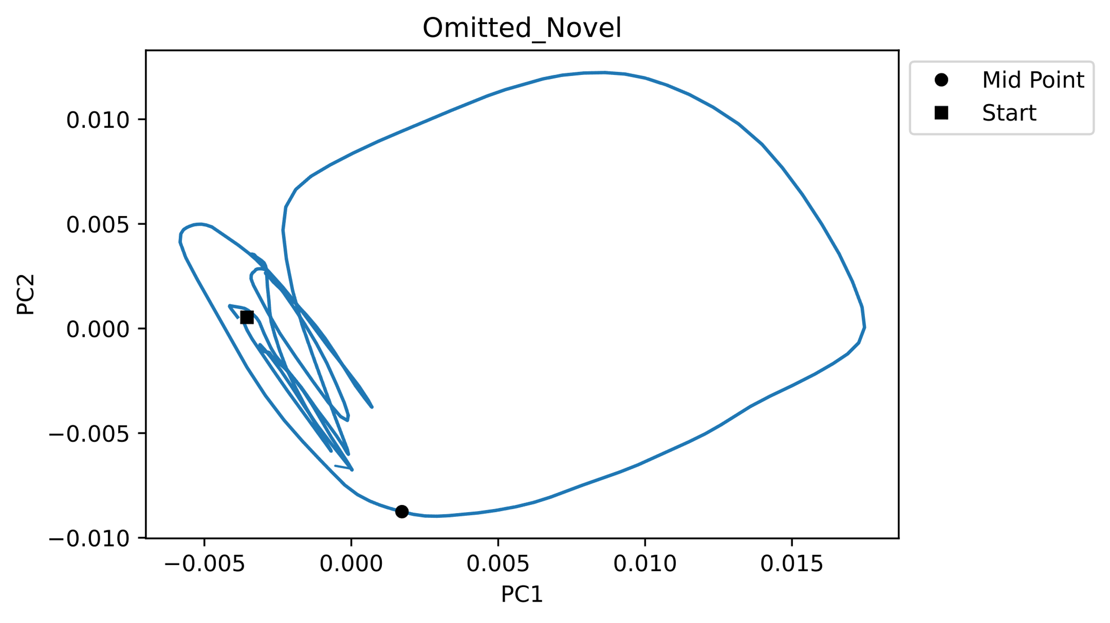
Results – 2 Stimulus omission doesn’t trigger attractor change.

Slide 6
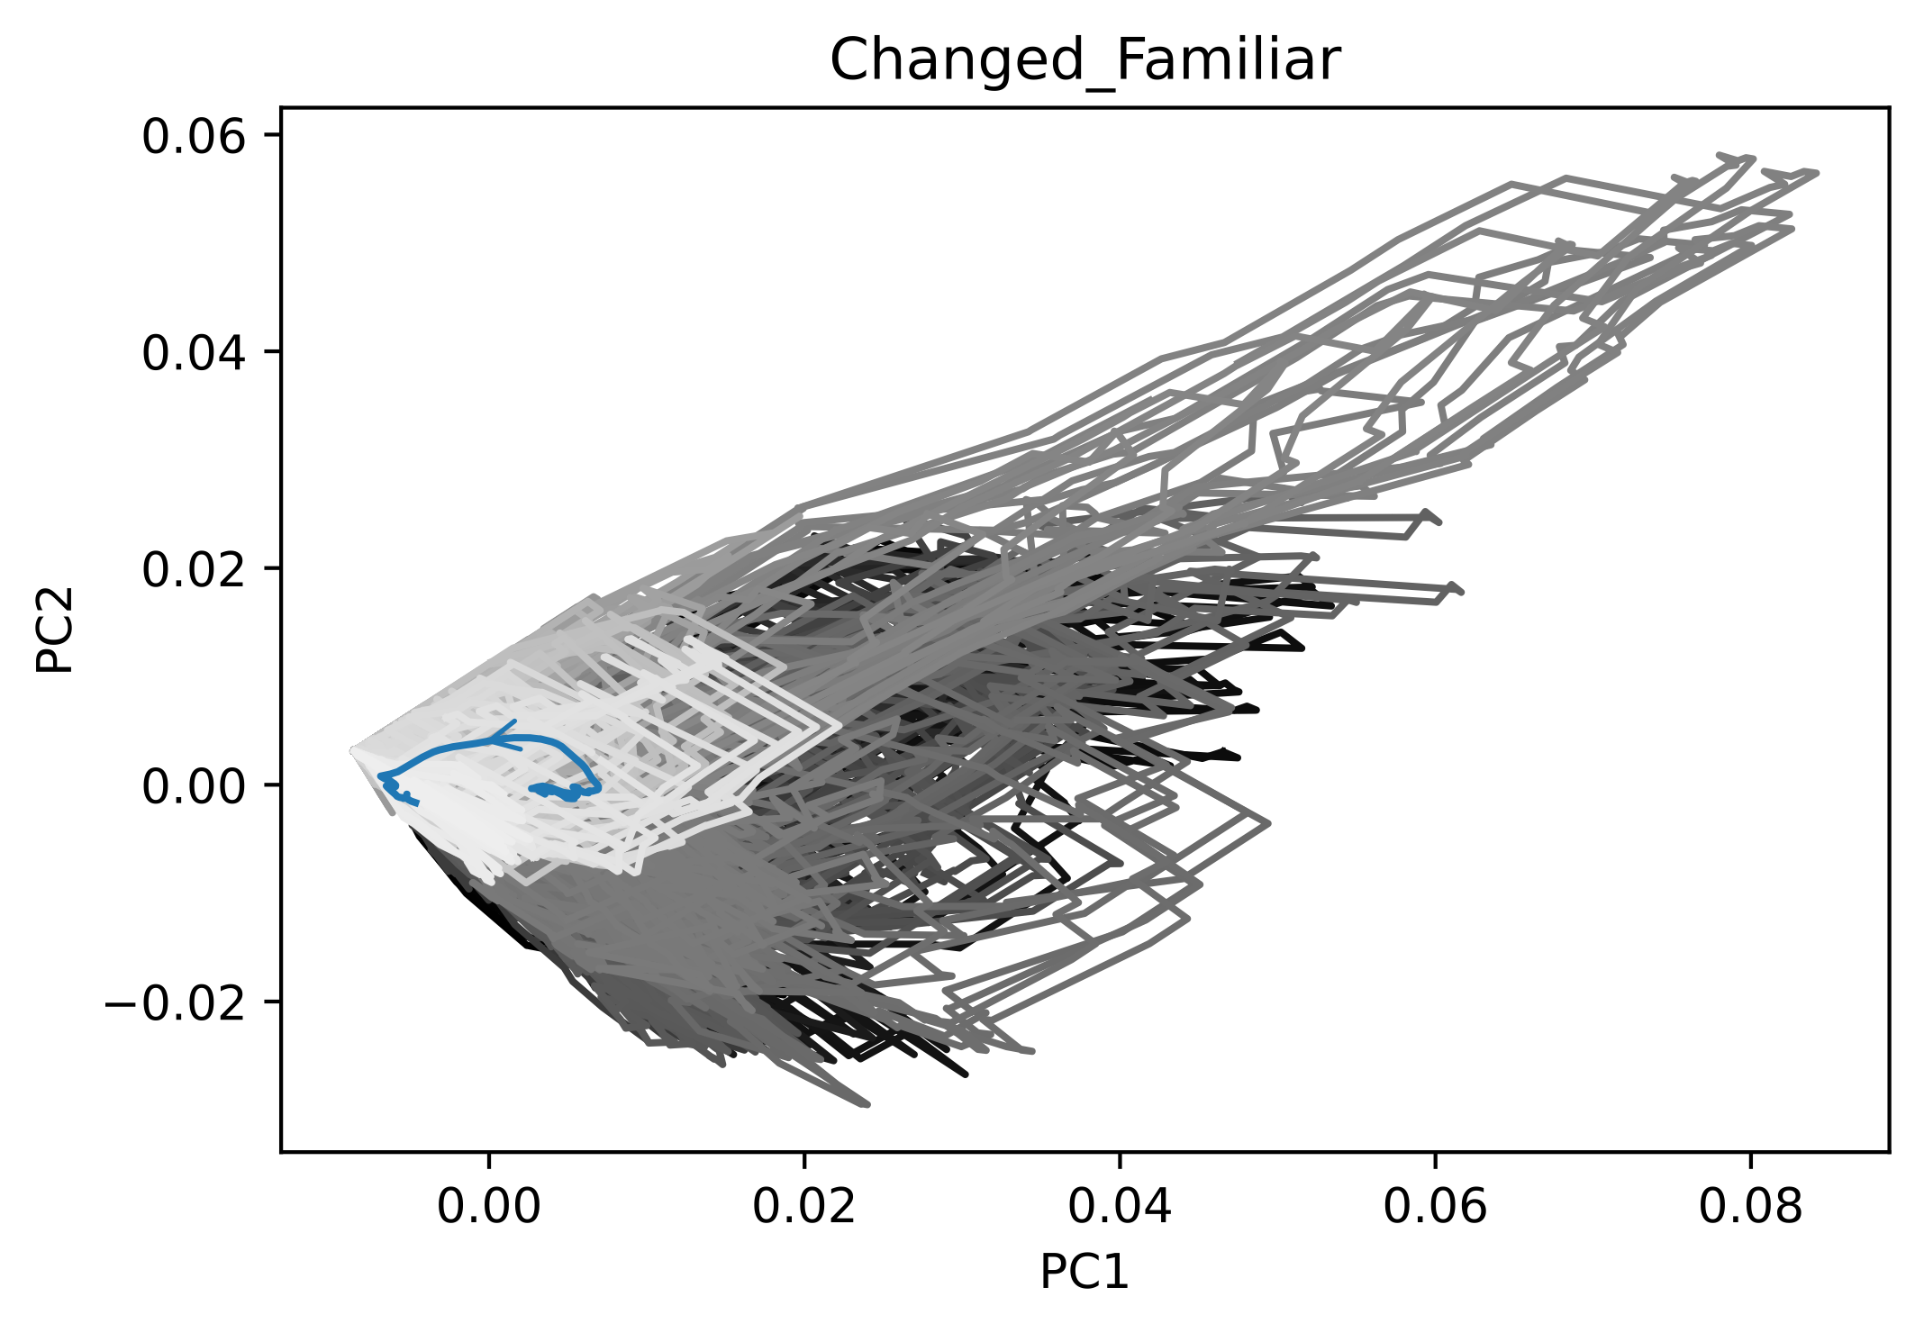
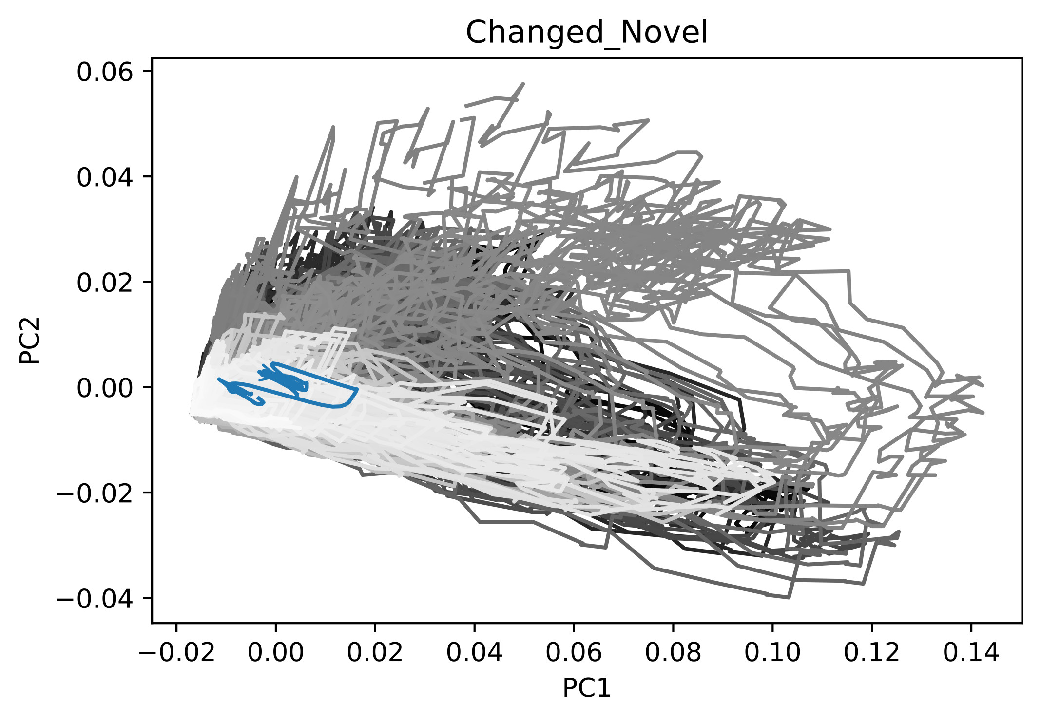
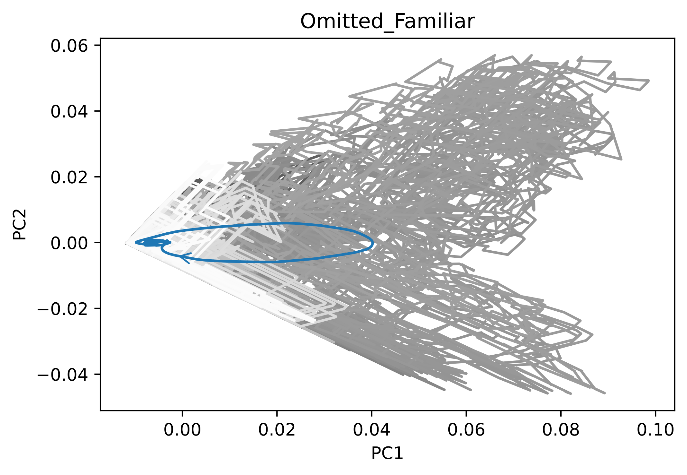
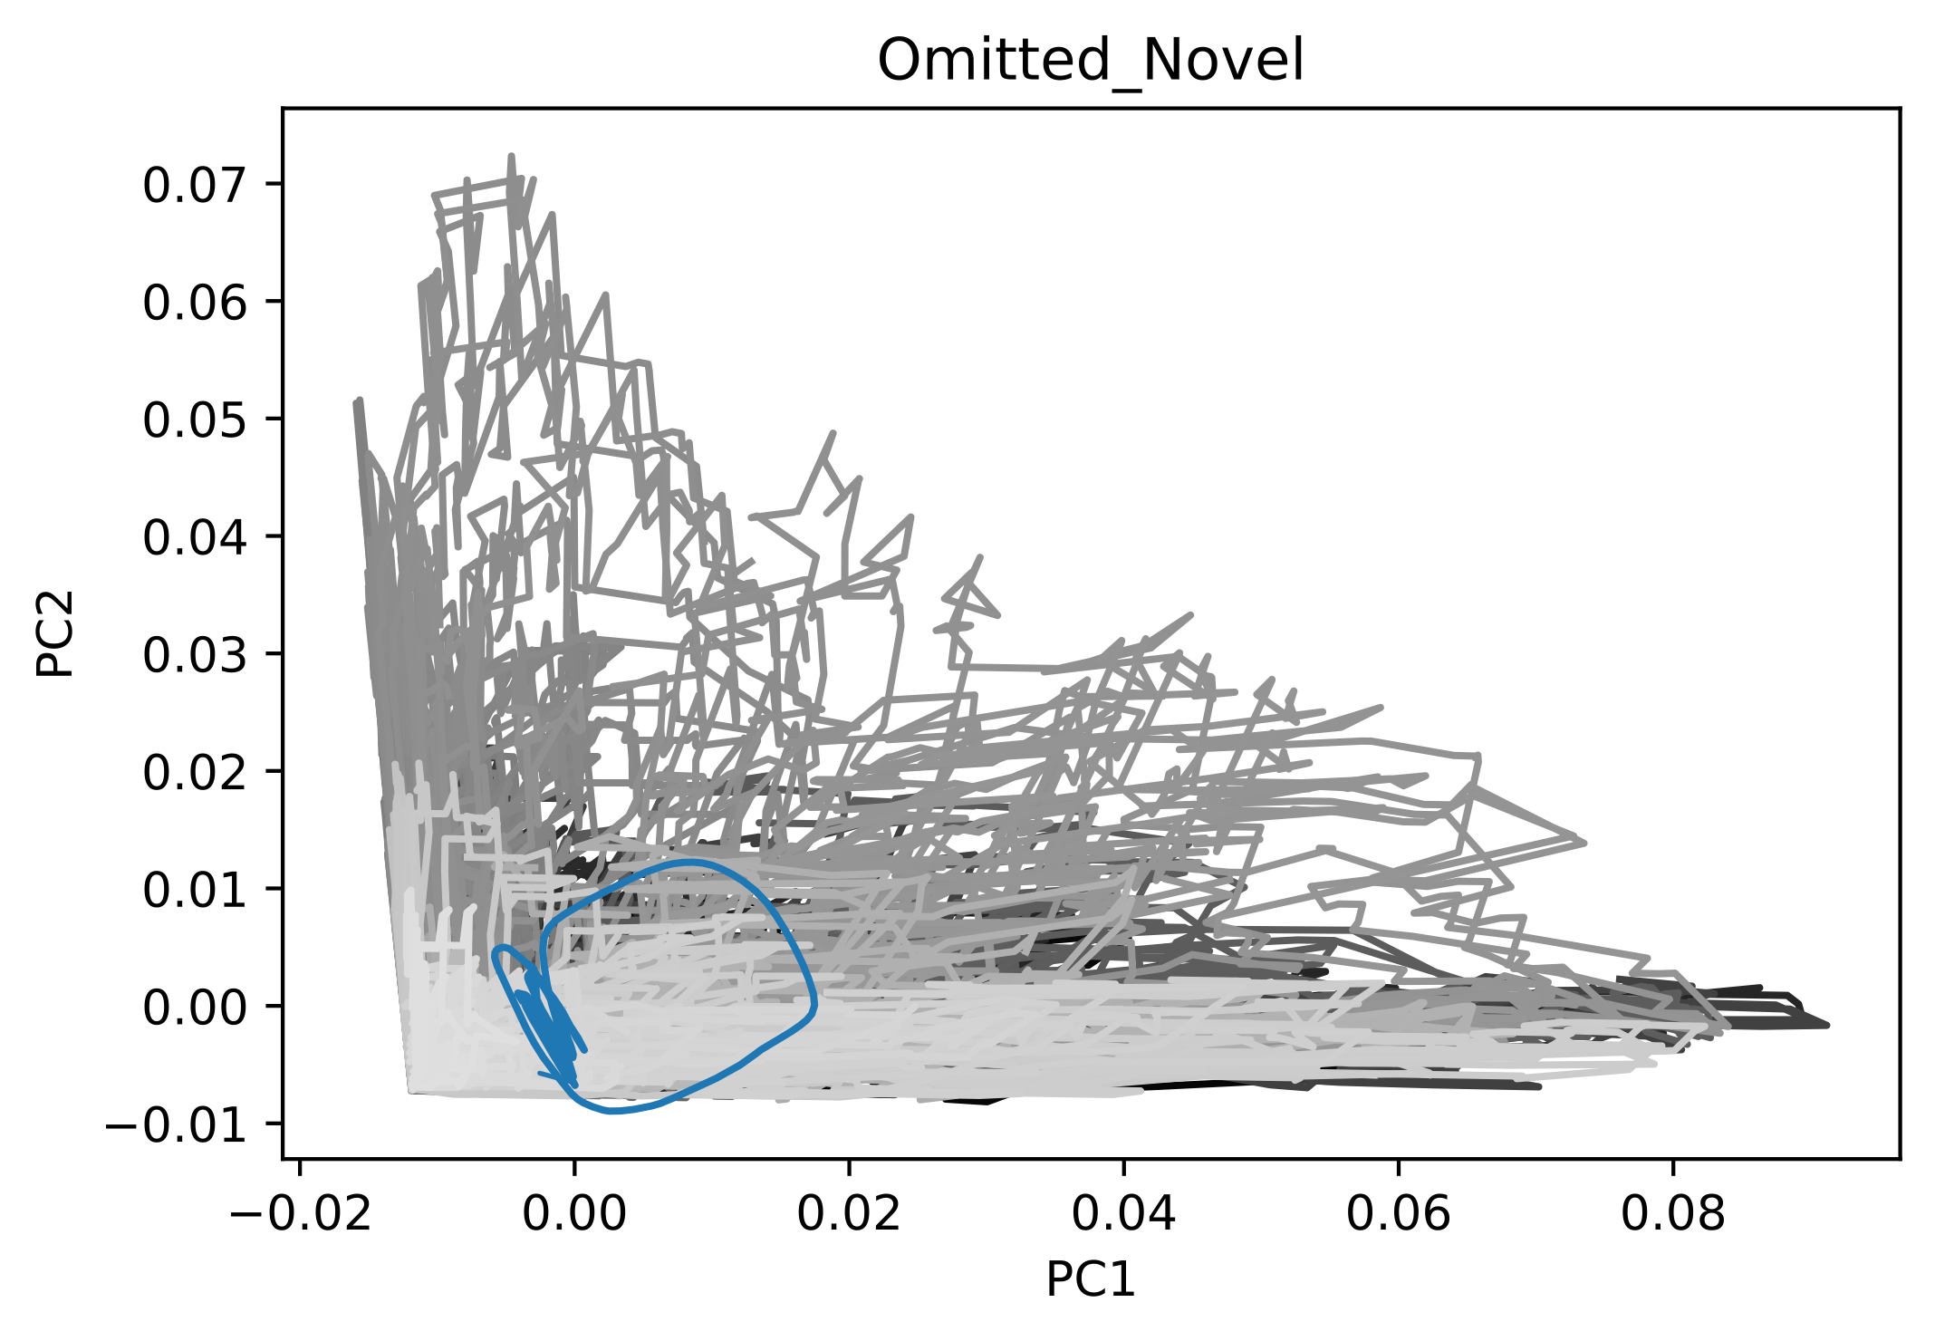
Results – 3 Trajectory goes back to the same attractor after omission of the stimuli.

Slide 7
Discussion
Dynamics for changes
Two attractors: Trajectory moves from one attractor to another (heteroclinic)
Explanation: Bifurcation in which one of the equilibria loses stability
Dynamics for omitted states
One attractor: Trajectory moves back to the original attractor (homoclinic)
Explanation: Bifurcation in which one of the equilibria loses stability
Excursion dynamics
Excursion in the PC-space before / around time of stimulus presentation
Explanation: Could be preparation / expectation of (familiar) stimulus
Dynamics across individual trials shows evaluation of variation
Variance small at beginning, then increases (could be arousal) and decreases for later trials
Needs to be further explored, esp. in relationship with behaviour (running) and arousal (pupil size)

Slide 8
Summary
Research Questions
Can we characterise VIP cell dynamics in low dimensional space?
Can we find traces of memory in the activity of cells?
Preliminary Findings
Two attractors in change detection tasks
One attractor in omission tasks
Traces of memory in the familiar tasks
Differentially responding VIP cells shape dynamics
Future Research
Explore single trial dynamics, and changes over time-course of sessions
Investigate covariates such as arousal state and running

Slide 9
Thank You

